Slide 1
Virtual reality therapy for refractory auditory verbal hallucinations in schizophrenia: A pilot clinical trial
Journal：Schizophrenia Research
Impact factor：4.569

Slide 2
Introduction
1. 80% of patients with schizophrenia(精神分裂症) will suffer from auditory verbal hallucinations (AVH, 言语幻听).
2. 40% to 60% of Treatment-resistant schizophrenia (TRS, 难治性精神分裂症) patients still do not respond to Clozapine(氯氮平).
3. Cognitive Behavioural Therapy (CBT) is effective in reducing the positive symptoms of schizophrenia, but the efficacy for TRS is uncertain.
4. Encouraging patients to enter in a dialogue with their voices may help them develop a more constructive relationship with their voices and reduces their feelings of helplessness.

Slide 3
Introduction
5. Leff et al. (2013) and Craig et al. (2017) used a computerized system enabling patients to create an avatar of their persecutor, the results showed large effects of the therapy on distress associated with AVH.
6. Our modifications to their trials:
(1) We used immersive virtual reality rather than conventional computerized technology.
(2) We delivered the therapy specifically to patients responding to the criteria of treatment resistance.

Slide 4
Methods
1. Participants: 19 patients (≥18 years old) with schizophrenia or schizoaffective disorder, diagnosed using the criteria of the DSM-5.
2. Group design
(1) VR-assisted therapy (VRT) group
Patients underwent 7 weekly sessions: one avatar creation session and six 45-minute therapeutic sessions.
First week, patients created an avatar best resembling the most distressing person or entity believed to be the source of the voice.(Unity3D, Morph3D, Roland AIRA VT-3, Samsung GearVR, Samsung Galaxy S6)
In sessions 1 to 3, patients were confronted to the reproduced hallucinatory experience. They were encouraged to enter into a dialogue with the avatar to improve emotional regulation and assertiveness.

Slide 5
Methods
(1) VR-assisted therapy (VRT) group(续)
Self-esteem was emphasized in session 4, which was reinforced by enabling the patients to express themselves and to consider their personal qualities.
Over the course of VRT, the avatar's interaction with the patient became gradually less abusive and more supportive.
In the final consolidation sessions, patients were encouraged to apply what they had previously learned in the experiential sessions.
(2) Treatment-as-usual (TAU) group
The group allocated to TAU consisted of antipsychotic treatment and usual meetings with clinician.
The TAU group then received a delayed 7 weeks of VRT. A follow-up was done 3 months after the last therapy session of VRT.

Slide 6
Methods
3. Clinical assessments(before and after trials)
(1) Psychotic Symptoms Rating Scale(PSYRATS)
(2) Beliefs About Voices Questionnaire-Revised(BAVQ-R)
(3) Positive And Negative Syndrome Scale(PANSS)
(3) Beck Depression Inventor(BDI)
(4) Quality of Life Enjoyment and Satisfaction Questionnaire-Short Form(QLESQ-SF)

Slide 7
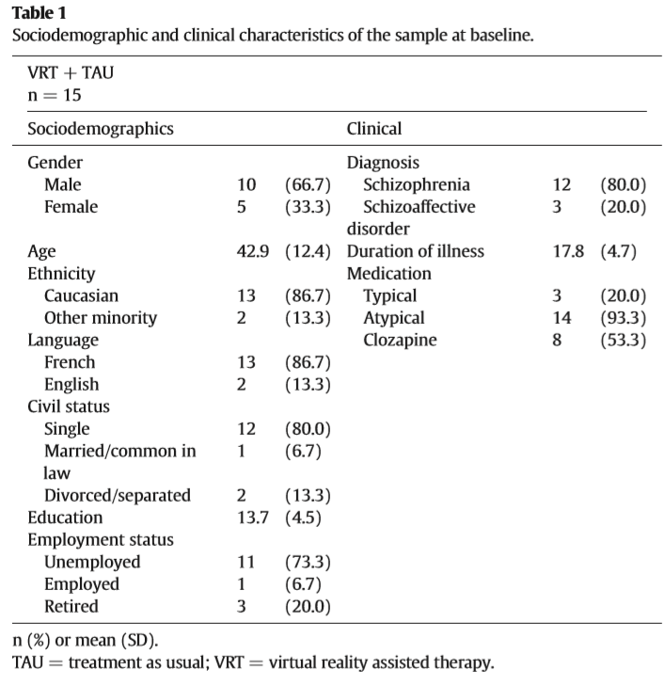
Methods

Slide 8
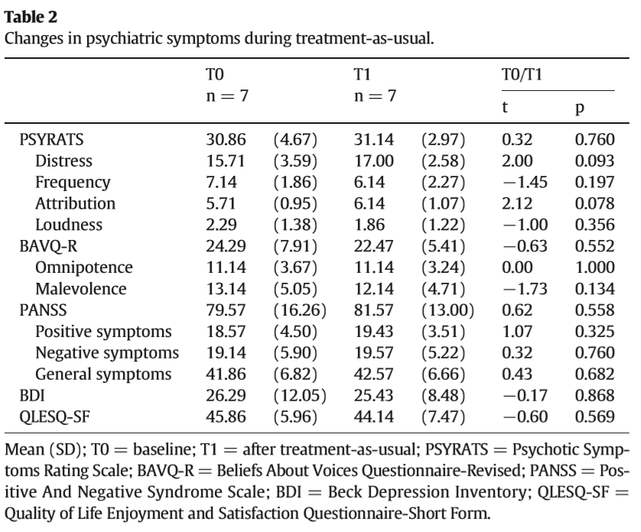
Result
1. The two first weeks are the most anxiogenic for patients.
2. Psychiatric symptoms remained unchanged throughout the TAU period.

Slide 9
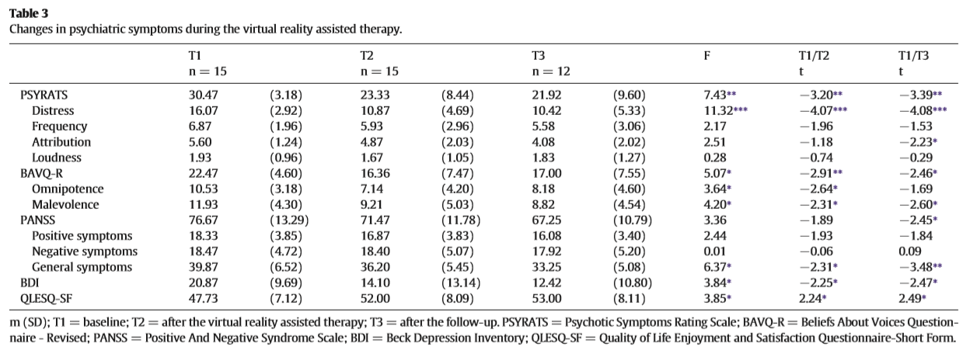
Result
3. There was a reduction of AVH symptoms as seen with the PSYRATS scores during VRT.
4. General symptoms as measured with the PANSS and depressive symptoms were diminished, while quality of life was ameliorated.

Slide 10
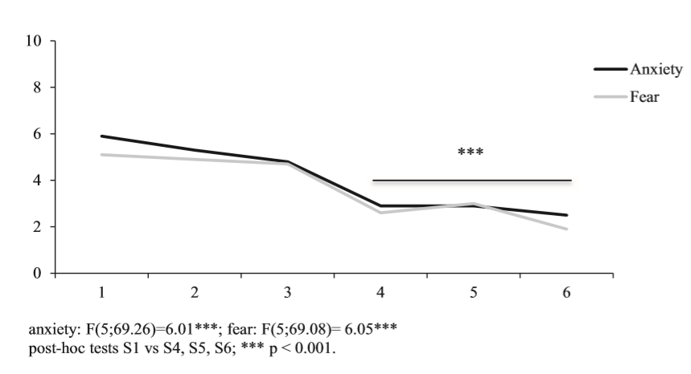
Result
5. Significant decreases in anxiety as well as fear occurred during VRT beginning at Week 4 .

Slide 11
Conclusion
1. VRT produced significant improvements in AVH severity, depressive symptoms and quality of life that remained stable at the 3-month follow-up period.
2. Although preliminary, the benefits reported are clearly superior to the benefits of any other available psychological treatment at the moment for TRS, at least to our knowledge.

Slide 12
Conclusion
3. Limitation
(1) TAU is a comparison condition that only controls for the effect of time, and does not allow to directly compare VRT to a proven efficient psychological intervention for TRS.
(2) The non-blinding to treatment allocation of the evaluator performing the clinical assessments and the non-inclusion of the data from dropouts.
(3) VRT requires a specific set of skills, principally “actor-like” qualities that are not traditional.

